Slide 1
Spring Cloud Config Server
https://cloud.spring.io/spring-cloud-config/
Denny Slover
St Louis Java User Group July 12, 2018
Demo Code:
https://github.com/denny2000/config-server
https://github.com/denny2000/config-server-demo
https://github.com/denny2000/config-server-properties

Slide 2
What is Spring Cloud Config Server? Spring/Pivotal Perspective
Spring’s summary of the Spring Cloud Config project (Source)
Spring Cloud Config provides server and client-side support for externalized configuration in a distributed system.
With the Config Server you have a central place to manage external properties for applications across all environments.
The concepts on both client and server map identically to the Spring Environment and PropertySource abstractions, so they fit very well with Spring applications, but can be used with any application running in any language.
As an application moves through the deployment pipeline from dev to test and into production you can manage the configuration between those environments and be certain that applications have everything they need to run when they migrate.
The default implementation of the server storage backend uses git so it easily supports labeled versions of configuration environments, as well as being accessible to a wide range of tooling for managing the content. It is easy to add alternative implementations and plug them in with Spring configuration.
Notes:
Paragraph from Spring.io projects page.

Slide 3
Reasons to use External Config Overview
Remove the application configuration from the code
Centralize the application’s configuration for all environments
Allow the configuration to be easily tailored to the environment and turn on/off feature flags.
{bonus} Allow the configuration to be changed in the application while the application is running without any service interruption.
Notes:
Why use a external config server

Slide 4
#3 on the 12 Factor Application
I. Codebase
II. Dependencies
III. Config
Store config in the environment
IV. Backing services
V. Build, release, run
VI. Processes
VII. Port binding
VIII. Concurrency
IX. Disposability
X. Dev/prod parity
XI. Logs
XII. Admin processes
https://12factor.net/
Notes:
Because of 12 factors!

Slide 5
How does it work?
The application, environmental and profile configuration are stored in a Git repo
The Config Server will pull the configuration as needed from the GIT repo.
When the applications start up, they will make a call to the config server to pull the config based on application name, profile and repository label.
Applications can be refreshed with new config by either restarting or calling the /refresh endpoint.
Notes:
Config in git
Config pulls from git
Apps pull from config server

Slide 6
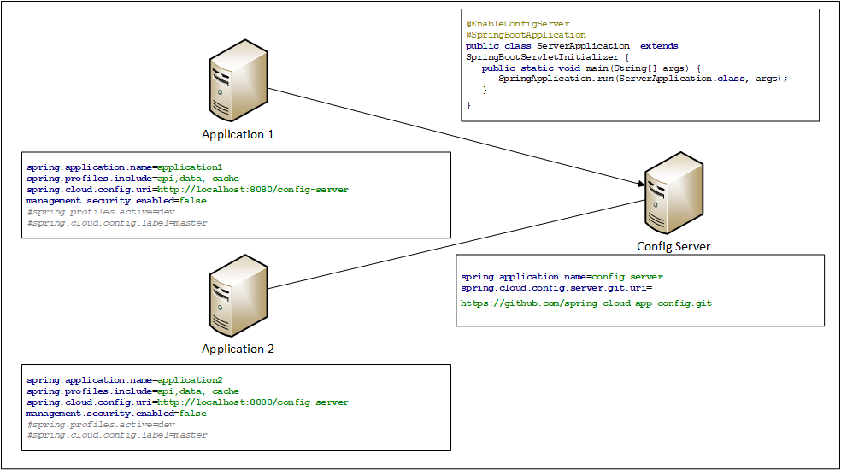
Code Needed
Note: This example doesn’t include the maven starter packs. Honestly, that code just isn’t nearly as exciting.
Notes:
Show code in config server and demo app

Slide 7
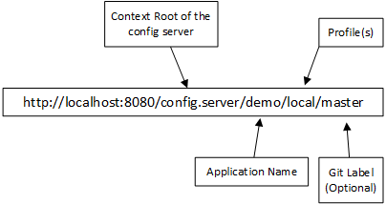
How the Applications pulls the Config from the Server
When the application starts up, it will call the config server with the application name, profile and the Git label.
The config server then retrieves the config form the Git repo and returns it to the application.
Using the Spring application name and profiles set in the bootstrap.properties file, the application can pull all the configuration it needs at start up.
There can be multiple profiles enabled for each application. Example → dev, data, caching, feature123
If the Git label is used, then the Config Server will pull the config from that label. The label can be a branch name, commit id, or tag.
Notes:
Show postman calls to pull the config
Different profiles
Master and develop branches

Slide 8
Property Files Hierarchy
application.properties
Stores config that is common to all applications and all profiles logging level defaults, common config
This is the lowest precedence properties file
<spring.application.name>.properties
Stores the config for the application.
Maps the application name to the “spring.application.name” in the bootstrap.properties file
application-<profile_name>.properties
Stores properties for a profile that will be used for all applications.
<spring.application.name>-<profile>.properties
Stores the properties specific to the application when the profile is activated
Highest precedence of all property files
Note: If multiple profile files are loaded with the same config keys, the last profile loaded will be the final value. Example: spring.profiles.include=api,data, cache → In this case the cache profile will overwrite any config keys in any other properties file.
Note: both .properties and .yml file formats are supported
Notes:
Go back to postman to show config server response

Slide 9
Demo Time!
Demo app
Show api with data object returned
Update the config in the git repo and show change in response
Show change of profile that affects the config
Show change of branch that affects the config
Show change in the config and refresh of the properties in the app

Slide 10
How does Refresh Work?
Add the @RefreshScope annotation to all beans.
Any beans that have the @Value annotation will need be refresh scope in order to have those properties refreshed.
This annotation enables a endpoint ( /refresh ) that, when called will invalidate the cache entry of every spring bean with the @RefreshScope annotation*
Since the bean cache is invalidated, any existing process will continue to use the existing bean but the next call to that class after the refresh will have the new config. This means no impact to the app stability (as long as the config is correct)
Refreshing the application servers can happen with a rest call (/Refresh) or a spring-cloud-bus (source)
*newer versions of Spring Boot require explicit enabling of the actuators management.endpoint.refresh.enabled=true management.endpoints.web.exposure.include=*
Notes:
How to make the dynamic refresh work
@RefreshScope
/refresh
Cache invalidation

Slide 11
Dynamic Refresh The Ideal Approach
Developer checks in new config changes to GIT
GIT server signals the config server by sending a message to the /monitor endpoint on the config server
Config server will then pull the latest config from the GIT server
Config server will send a message to each application that is affected
Each application will then call to the config server to get the latest config
Notes:
Config changes flow from git to the application

Slide 12
Dynamic Configuration Refresh at Runtime – Last Mile
Spring-cloud-bus
The refresh message is broadcasted to all the applications using a message broker, such as RabbitMQ or Kafka.
This seems like the best and cleanest solution to dynamically refresh the configuration while the apps are running. This is also the recommended solution from Pivotal/Spring
http://cloud.spring.io/spring-cloud-config/single/spring-cloud-config.html#_push_notifications_and_spring_cloud_bus
Call the /refresh endpoint
Leverage Service Registry
Use the service registry to pull all instances currently running and call each instance’s /refresh endpoint
Notes:
Using Rabbit MQ
Call the /refresh endpoints

Slide 13
Brute Force Refresh Method
Schedule an internal /refresh call in each app
With about 20 lines of code, an app can automatically schedule the refresh.
@Slf4j @Configuration @EnableScheduling public class ConfigScheduler { private RestTemplate restTemplate = new RestTemplate(); @Scheduled(cron = "0 0/15 * * * *") public void refreshCofig(){ HttpHeaders headers = new HttpHeaders(); headers.add("Content-Type", "application/json"); HttpEntity<MultiValueMap<String, String>> requestEntity =
new HttpEntity("", headers); log.info("Refreshed: {}",
restTemplate.postForObject(
"http://localhost/actuator/refresh",
requestEntity,
String.class)); } }
Notes:
Scheduled job to call itself to refresh

Slide 14
Protecting Sensitive Data
What about config files that include passwords or other sensitive data?
Encrypt!
spring:
datasource:
username: dbuser
password: '{cipher}FKSAJDFGYOS8F7GLHAKERGFHLSAJ'
spring.datasource.username: dbuser
spring.datasource.password: {cipher}FKSAJDFGYOS8F7GLHAKERGFHLSAJ
Notes:
How to protect resting data in the config files

Slide 15
Encrypt/Decrypt Endpoints
POST localhost:8888/encrypt
Post the data that needs encrypting, the return value will be the encrypted data
POST locahost:8888/decrypt
Post encrypted data, the return value will be the decrypted value
Demo
Notes:
Encrypt and decrypt endpoints
Demo the encryption and decryption endpoints
Show the application with decrypted data
Show the app with encrypted data

Slide 16
Alternatives to Version Control Option #1
File System (source)
Use the local file system
Config server will pull from the path(s) listed in the configuration
Can use native file system or a local GIT repo
Notes:
File system
Git or native

Slide 17
Alternatives to Version Control Option #2
JDBC/Database (source)
Create a PROPERTIES table
Add the configuration to the PROPERTIES table
Add spring-jdbc to the config server class path
Using the jdbc profile or adding a bean of type JdbcEnvironmentRepository
Notes:
Database storing the cofiguration

Slide 18
Further Reference
Spring Cloud Config Reference Guide – Latest version (2.0.0.RC1)
http://cloud.spring.io/spring-cloud-static/spring-cloud-config/2.0.0.RC1/single/spring-cloud-config.html
Spring Cloud Bus Reference Guide – Latest version (2.0.0.RC1)
http://cloud.spring.io/spring-cloud-static/spring-cloud-bus/2.0.0.RC1/single/spring-cloud-bus.html
Spring Cloud Reference Guide – Latest version (Finchley RC1)
http://cloud.spring.io/spring-cloud-static/Finchley.RC1/single/spring-cloud.html

